Slide 1
Executive presence and your brand
What is it, and how to I get it
Nancy R Martin

Slide 2
Executive Presence
The “it” factor
What is it?
And what does it look like?

Slide 3
Executive Presence
The “it” factor
Credibility
Warmth & authenticity
Sense of humor
Salesmanship
Inspiring
Appearance
Energetic
Approachable
Optimistic/realistic
Inclusive
Honest
Great communicator
Courage
Resilience
Assertive
Self-confident

Slide 4
Executive Presence
The “it” factor
Credibility – do what you say you will do
Say what you know. Say what you don’t know. Say when you must keep a confidence and say when you are guessing.
Warmth & authenticity – care about people and be ourselves
Sense of humor – it is okay to joke around, if appropriate – if you are funny.
Or at least don’t take yourself too seriously all the time
Salesmanship – you need to be able to sell ideas, products and projects

Slide 5
Executive Presence
The “it” factor
Inspiring
Motivate others
Though expertise, vulnerability, encouragement and hope
Appearance
Do you look professional? Do you convey you care about yourself?
Energetic
Regardless of the situation, you can bring energy to a situation or group to propel them forward
Approachable
Do people feel they can tell you the truth? Can they tell you about problems?

Slide 6
Executive Presence
The “it” factor
Optimistic/realistic – you need to be realistic AND provide hope
Inclusive – do we include everyone? Think about a global organizations
Honest – Tell the truth. Say what you know. Say what you don’t know. Keep secrets and say when you are guessing
Communication – Develop this skill! Speaking, listening, writing
Resolve conflict

Slide 7
Courage
Having courage to try new things
Be Bold

Slide 8
Resilience
Bounce back when things don’t work

Slide 9
Self–Confidence
What we feel in the inside
Assertiveness
What shows on the outside

Slide 10
Your Brand

Slide 11
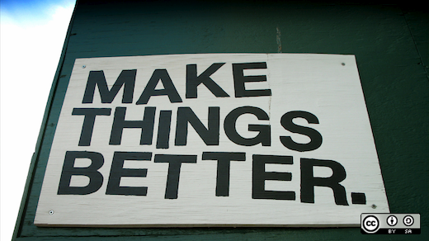
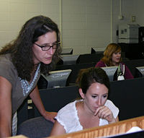
The concept of “your brand”
Unreliable
Analytical
Pessimistic
Gets Stuff Done

Slide 12
“Watch your thoughts, they become your words;
watch your words, they become your actions;
watch your actions, they become your habits;
watch your habits, they become your character;
watch your character, it becomes your destiny.”
― Lao Tzu

Slide 13
You have a brand. Your team has a brand
And brands can change!

Slide 14
Clues: Your brand reflects how you feel (your thoughts)
What emotions do you carry with you?
Emotions ooze out and define you
What emotion do you feel at work?
Happy, excited, frustrated, serious….
What emotion do people have when they are with you?
Happy, afraid, frustrated, bored, awe, thrilled, inspired

Slide 15
Clues: Your brand reflects how you speak
How do you talk about your work?
Bored, excited, enthusiastic, serious
How do you talk about what you accomplish?
What you talk about is what you will be known for
What do you lead with?
Bring forward – talk about things you want to highlight

Slide 16
Clues: Your brand reflects what you do
What have you done lately?
On-time? Extra effort? Late? Complete?
Innovative, creative, accurate, team player

Slide 17
What do you want your brand to be?
You can have different brands with different people
What do you want your manager, peers, family to think about you?
And what do you think they would wish you were?
Wise, commanding, intelligent, helpful, supportive, busy, executes, problem solver, leader, expert?

Slide 18
Do your words and actions match? We see ourselves through our intentions

Slide 19
Does your brand match what your organization needs?
Sunny disposition ≠ Analytical
Technical ≠ Leader
Innovative ≠ Gets stuff done
Gets stuff done ≠ Innovative
Party planner ≠ Engineer

Slide 20
Who do you want to be?
Align your thoughts, words and actions

